Slide 1



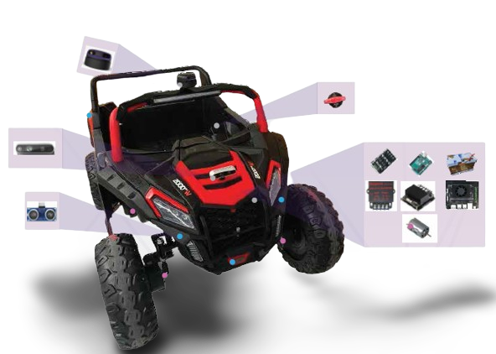
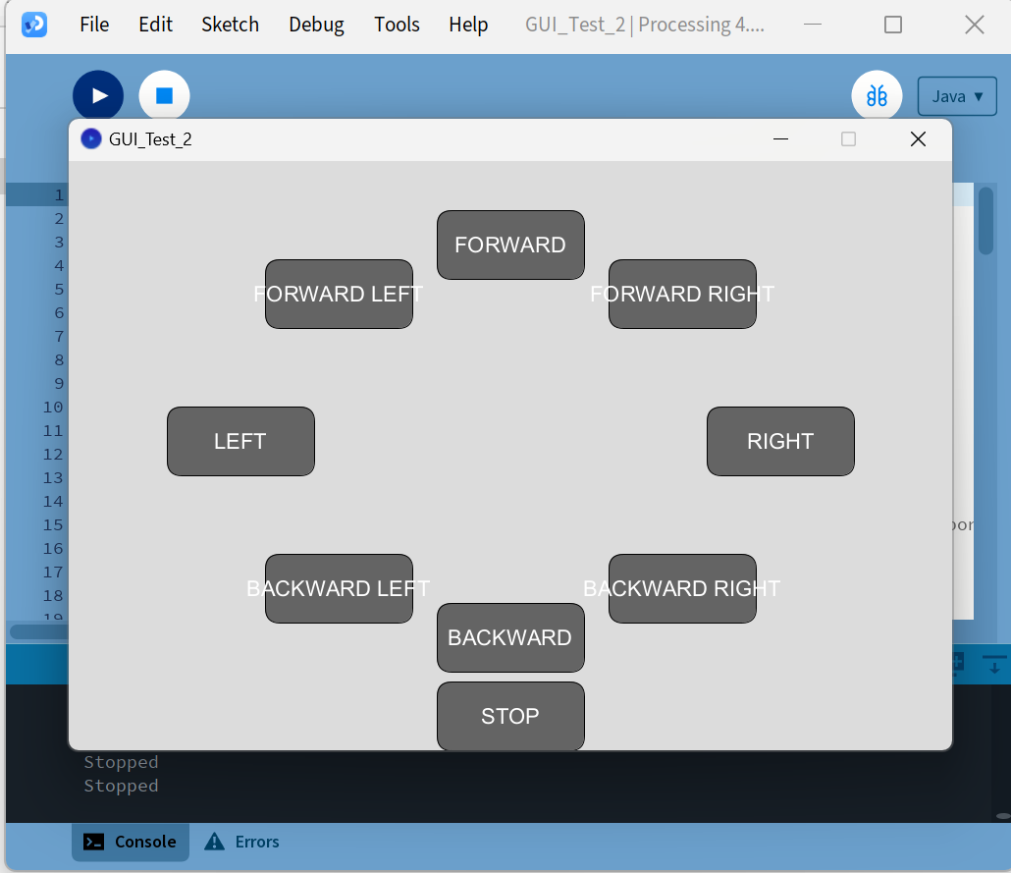
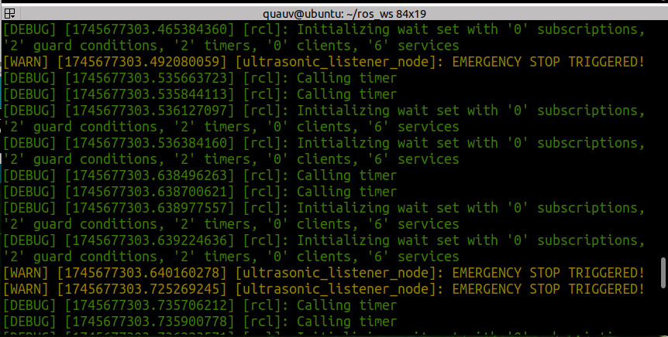
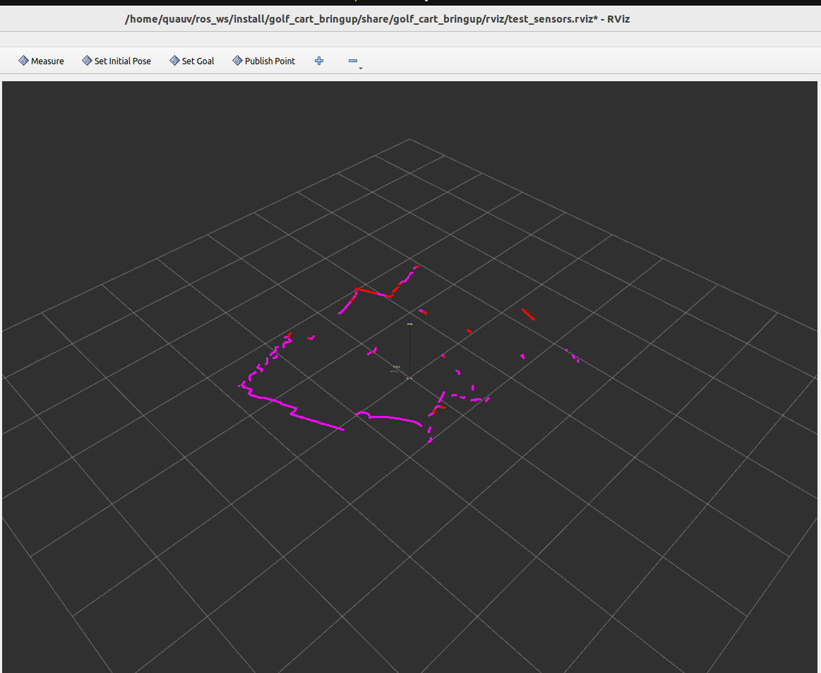
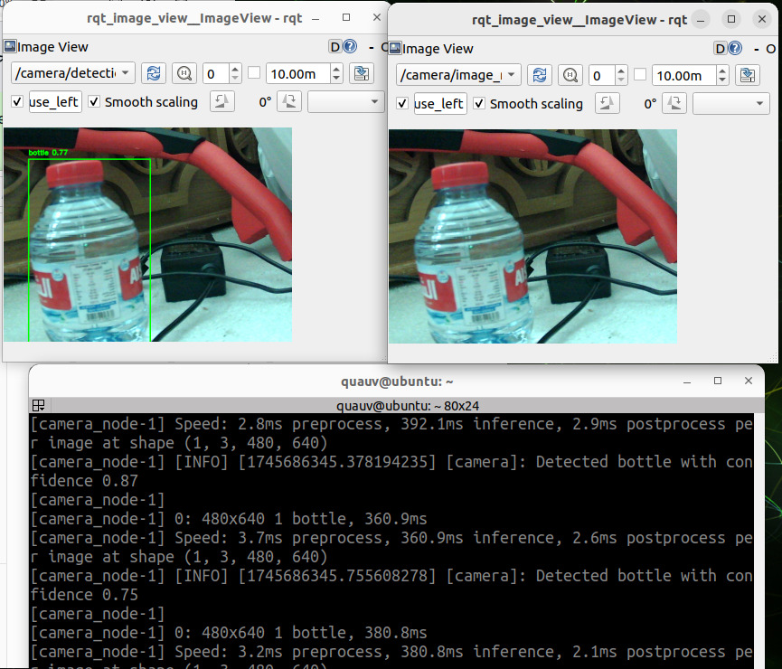
Autonomous Golf Cart
Abdelaziz Shehata • Zabin Al-Dosari • Abdulla Musa
Dr. Uvais Qidwai
Introduction
This project develops a Level 4 autonomous golf
cart for safe navigation in controlled environments.
Built on ROS 2 and Jetson Orin NX, the system
integrates real-time sensing, mapping, and motion
control. A working prototype on a compact vehicle
demonstrates key features and sets the stage for
future full-scale deployment.
Implementation and Testing
Final Design
System connectivity
Problem Statement
Transportation in controlled environments, such as campuses and resorts, faces challenges:
inefficiency, high operational costs.
Safety risks due to human error, which causes 90% of traffic incidents globally.
Environmental concerns from fossil fuel use.
Project Objectives
Develop a Level 4 autonomous golf cart.
Integrate advanced sensors.
Use ROS 2 for sensor fusion and real-time communication between components.
Process data in real time.
Implement obstacle detection and avoidance.
Develop navigation and path planning algorithms
Ensure cost-effectiveness.
Thoroughly test and validate.
Project Constraints
Technical & Design Constraints
Real-Time Responsiveness.
Power Efficiency.
Environmental Impact.
Safety & Collision Avoidance.
Data Security & Privacy.
Logistical & Organizational Constraints
Limited Time.
No Initial Golf Cart.
Small Team Size.
No Workspace Initially.
No Financial Sponsorship.
This figure illustrates the finalized prototype implementation of the autonomous vehicle system. All core components are fully integrated and mounted onto a motorized platform. The setup reflects the complete system architecture, with optimized wiring, proper sensor placement, and stable power distribution. This configuration allows for reliable testing of autonomous functions such as perception, obstacle detection, and motor control, serving as a working prototype ready for future deployment on a full-scale golf cart.
GUI
The system uses a modular hardware architecture
centered on the Jetson Orin NX, integrating sensing,
vision, control, and power subsystems for autonomous
operation. This design ensures flexibility, scalability,
and ease of testing and future upgrades.
Emergency Brake
Results
Modular System partially Integrated: All subsystems (Jetson, Arduino, sensors, drivers) successfully connected and operational.
Real-Time Obstacle Detection: Ultrasonic sensors achieved responsive emergency stop within 0.2 seconds for objects closer than 30 cm.
Perception Pipeline Operational: RealSense and LiDAR streams integrated and visualized through ROS 2 and RViz2.
Motor Control Reliable: Steering and propulsion via Arduino + MDDS30 & MD20A drivers confirmed to respond correctly to commands.
Stable Power System: Jetson and peripherals powered via 24V battery and buck converter without voltage drops.
Functional Prototype Completed: System successfully deployed on a small electric vehicle for testing.
Lidar on Rviz
High – Level Architecture
Conclusion and Future Work
This project successfully demonstrates a functional prototype of a Level 4 autonomous golf cart system, developed using ROS 2, Jetson Orin NX, and a suite of sensors. Key functionalities such as obstacle detection, emergency stopping, and environment mapping were
achieved on a modular test platform. The system lays a strong foundation for future upgrades like full navigation, YOLO-based object detection, and deployment on a full-scale golf cart.
Transition to a Full-Sized Golf Cart
Enhanced Object Detection and Avoidance
Advanced Path Planning and Navigation
Improved System Calibration and Performance Tuning
Power and Runtime Optimization
Security and Data Handling Enhancements
Expanded Testing Conditions
Reintegrating a depth-sensing camera
Emergency Brake
The system uses a modular hardware architecture centered on the Jetson Orin NX, integrating sensing, vision, control, and power subsystems for autonomous operation. This design ensures flexibility, scalability, and ease of testing and future upgrades.
Computer Science and Engineering Department
Qatar University
2024 – 2025

